Slide 1
Chapter 6
Social Media Analytics: Applications and Privacy

Slide 2
OUTLINE
Social media in public sector - Analyzing public sector social media,analyzing individual users, case study.
Business use of Social Media - Measuring success, Interaction and monitoring, case study.
Privacy - Privacy policies,data ownership and maintaining privacy online.

Slide 3
Traditional Media Vs Social Media
Reach: Traditional media (such as television, radio, and print) often have a wider reach compared to social media, as they can be accessed by people without internet access. Social media, on the other hand, is limited to those who are connected to the internet.
Target audience: Traditional media allows for targeting specific demographics through programming or content. Social media allows for targeting based on interests, behaviors, and demographics.
Cost: Traditional media can be expensive to advertise on, as it requires purchasing airtime or ad space. Social media advertising can be more cost-effective, as it allows for targeting specific groups and allows for adjusting campaigns based on performance.

Slide 4
Traditional Media Vs Social Media
4. Control: Traditional media allows for more control over the message being delivered, as it is a one-way communication. Social media allows for less control, as it is a two-way communication and allows for audience interaction and the spread of information beyond the intended audience.
5. Speed: Traditional media often has a slower turnaround time for creating and distributing content, as it requires production and distribution processes. Social media allows for faster dissemination of information, as it can be shared instantly.
6. Engagement: Social media allows for more engagement with the audience, as it allows for two-way communication and the ability to respond to comments and feedback. Traditional media has a lower level of engagement, as it is a one-way communication.

Slide 5
Social Media in Public Sector
Improved communication with the public: Social media platforms allow public sector organizations to directly communicate with the public, providing real-time updates and information about services and initiatives.
Increased transparency: Social media can help increase transparency in government operations by providing a platform for open communication and allowing the public to directly engage with and ask questions of government officials.
Improved customer service: Social media can be used as a customer service tool, allowing public sector organizations to quickly and effectively address issues and concerns raised by the public.

Slide 6
Social Media in Public Sector
Greater reach and engagement: Social media allows public sector organizations to reach and engage with a wider audience, including those who may not traditionally interact with government.
Enhanced community involvement: Social media can be used to facilitate community involvement in government decision-making and facilitate collaboration between government and community organizations.
Increased efficiency and cost savings: By using social media for tasks such as answering frequently asked questions, public sector organizations can save time and resources that would otherwise be spent on more traditional forms of communication.
Enhanced crisis management: Social media can be used to quickly disseminate important information during a crisis and coordinate responses.

Slide 7
Social Media in Public Sector
Public Procurement
Role of Civil Servants
Social Media
Commercial Contents
Accessibility
Problems

Slide 8
Social Media Usages by Individual / Organization
Broadcast /Sending Information
Request/ Feedback Input
Conversation Interaction

Slide 9
Analyze How Individual/ Organization is using Social Media?
Who is doing the posting?
Who are the target audience members?
Why is the audience engaged in social media with the organization?
What type of content or interaction is the audience interested in?
What are the goals of the user? Which of the three interaction methods above are they using?
How is the user using social media?
Do the user’s actions support the goals?

Slide 10

Case Study 1
A scene from the surveillance video released by the Philadelphia Police Department on YouTube and through other social media to help capture the man who attempted to abduct a 10-year-old girl.

Slide 11
Case Study 1- Social media to solve an attempted child abduction
The Philadelphia Police Department has effectively utilized social media platforms such as YouTube, Facebook, and Twitter to gather information about crimes and alert the public about emergencies.
They have also used smartphone apps to allow people to report incidents and locate local police stations. The department has reported successfully catching 87 suspects through their use of social media.
In addition, the department has found that social media can be an effective way to receive information from people, as demonstrated by several witnesses identifying a suspect in an attack after the department posted a video of the incident online.
The department has found success in not overwhelming their audience with too much content, posting to Twitter less than 10 times a day, and targeting relevant information to their audience.
To further optimize their social media strategy, the department can analyze the demographics of their followers and survey them about their reasons for following the department.
They can also engage in conversations with their audience and interact with other departments to share best practices.

Slide 12
Case Study 2 : Predicting elections and astroturfing
Social media has become important for political campaigns to reach voters.
Attempts have been made to use social media trends to predict election outcomes, with initial success but limited overall accuracy.
The volume of social media posts about a candidate may not accurately reflect public opinion.
Social media can be effective in generating interest and support for issues and causes.

Slide 13
Exercise: Case Study
Choose a popular current issue of public debate (a bill under consideration, an election, or a political issue). Search Twitter for posts about that issue.
What opinions are you able to find? Summarize them.
Is one opinion dominating the others?
Do you find a lot of content repeated? Perhaps one or two tweets that are repeated by many accounts? Does this appear suspicious, or is there a reason for it?

Slide 14
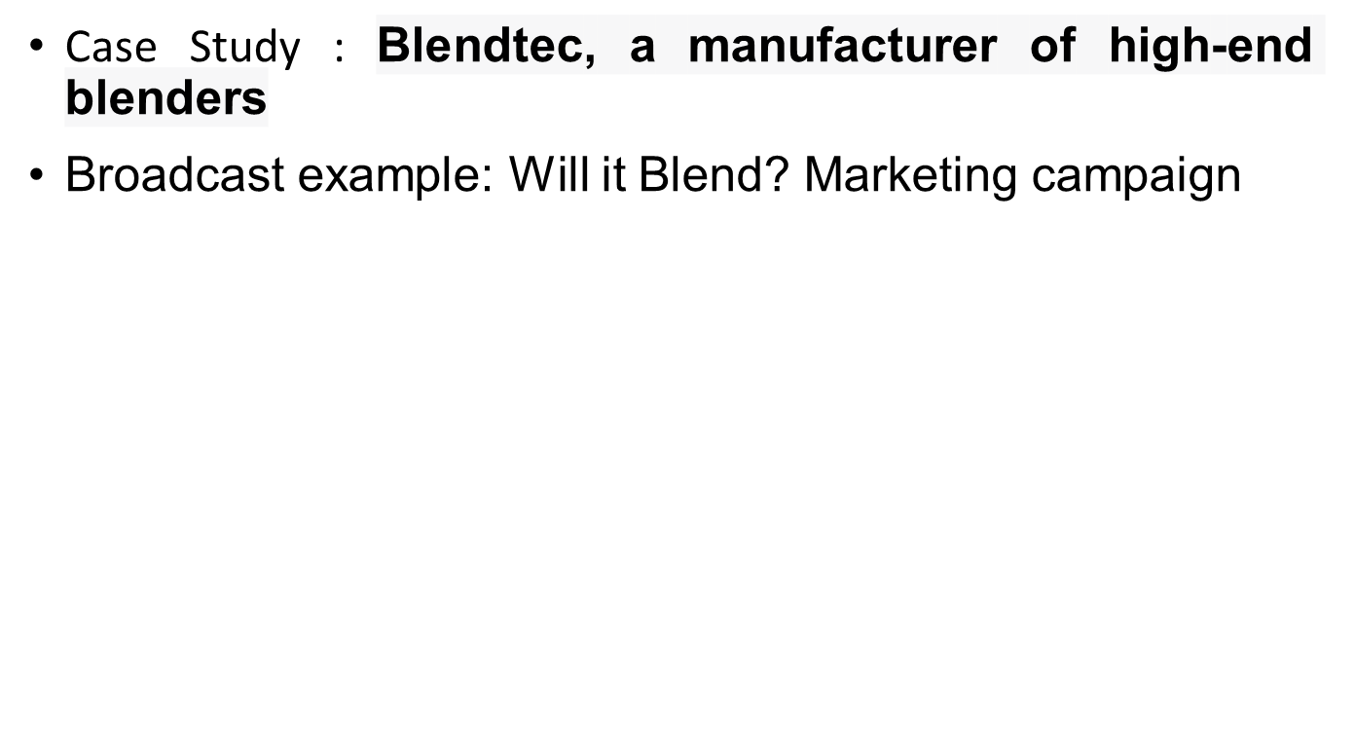
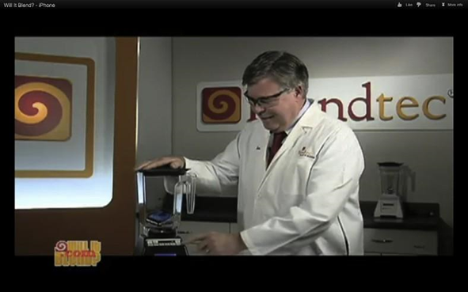
Business Use of Social Media
An example of a “Will It Blend?” YouTube video, showing the blender being used on an iPhone.

Slide 15
Business Use of Social Media
Blendtec, a manufacturer of high-end blenders, has had a highly successful social media campaign through their "Will It Blend?" series on YouTube, in which the company's founder demonstrates the power of their blenders by blending unusual and sometimes absurd objects.
This humorous approach has gained the company a significant following and helped to increase sales.
Their top-viewed videos have well over 10 million views each, and their collection of videos all together have 200 million views. The company’s YouTube channel has over 400,000 subscribers.

Slide 16
Case Study 2- Interaction and monitoring example: Zappos customer service
Zappos is an online retailer known for its excellent customer service and successful use of social media.
The company interacts with customers on Twitter and Facebook, and has a dedicated Twitter account for customer service inquiries.
A small team of customer service representatives handle these inquiries, with an average response time of under an hour.
Zappos' online customer service interactions can also be seen by other social media users, helping to improve the company's reputation.
Zappos proactively reaches out to customers with problems, even if they have not contacted customer support directly.

Slide 17
Case Study 3 : Social Media Failure
Social media failure example: Celeb boutique and the NRA
Social media mistakes can have significant impacts on a business' reputation and can spread quickly.
The National Rifle Association (NRA) made a mistake by posting a tweet that was inappropriate given the news of a mass shooting, and quickly deleted the tweet and the account.
Celeb Boutique made a similar mistake by trying to capitalize on a trending topic related to a mass shooting, and faced skepticism and backlash despite issuing an apology.
Businesses should be careful about what they post on social media and consider how their content may be perceived by others.
Connecting a product to a negative idea on social media can generate negative feelings about a brand.

Slide 18
Exercises/Case Study
Come up with five companies or brands you interact with regularly. For example, the companies could be a beverage bottler, restaurant, clothing brand, or technology company. For each of the five, find all the social media accounts you can. These will usually include a Facebook page, often a Twitter or YouTube account, and they may be present in many other types of social media.
List each company and their social media accounts.
Find as many counts for each social media account as described in the section on measuring success.
How often does the company interact on their social network site? Is it many times a day, a few times a week, or never?
What kind of interaction is the company doing? Broadcast, request for input, direct interaction, or a combination? Provide an example of each.
Assess the company’s social media strategy. What are they doing well and why? What could they do better, why would that be better, and how should they do it?
Find a major company offering customer service on Twitter. Search Twitter to find the 10 most recent customer service interactions they have had.

Slide 19
Exercises/Case Study
Find a company that has undertaken a viral marketing campaign over social media.
What is the essence of the campaign?
What metrics can you use to measure it (number of views, fans, likes, etc.)?
Is the campaign ongoing, or did it run for a fixed amount of time?
Are any statistics available to indicate the success of the campaign? If so, what are they?

Slide 20
Privacy
Privacy -
Privacy policies,
Data ownership and maintaining privacy online.

Slide 21
Privacy
Social media privacy refers to the protection of personal information and communication on social media platforms.
It is important to be aware of privacy settings and to carefully consider what personal information is shared online.

Slide 22
Privacy
Protect personal information and communication on social media.
Be aware of privacy settings.
Carefully consider what personal information is shared online.
Be cautious about accepting friend requests or connecting with strangers.
Be aware of potential scams or phishing attempts.
Use strong, unique passwords and enable two-factor authentication if available.
Review the privacy policies of social media platforms.
Limit the amount of personal information provided.

Slide 23
Privacy Policies and Settings
Social media has made it easier for people to share information online.
The default privacy settings on social media platforms have become more public over time.
Many people use privacy settings to restrict who can see their information, but some have difficulty understanding and using these settings.
Privacy policies detail how a social media site collects, uses, and shares user data, which may include personal information, location, and posts.
It is important to carefully review privacy policies and understand what information is being shared.
Some social media sites have more robust privacy controls and policies than others.

Slide 24
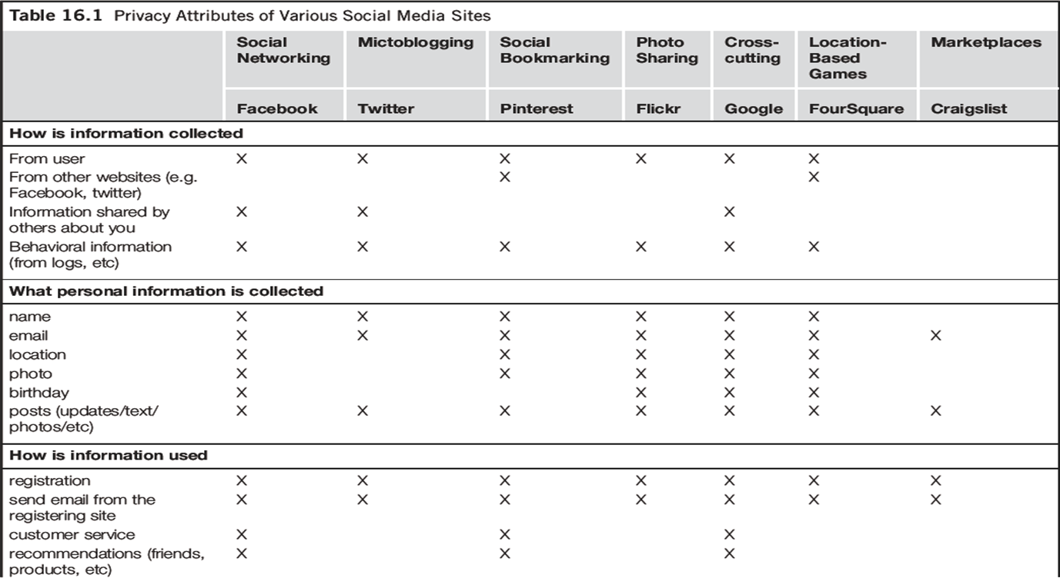


Slide 25
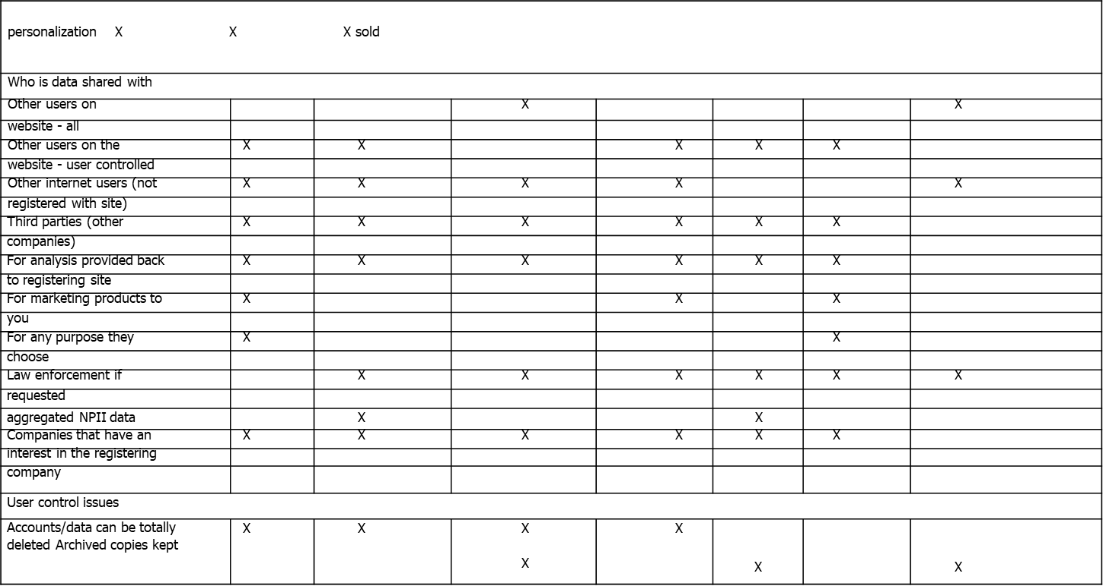

Slide 26
Aggregation and Data Mining
It is challenging to remain anonymous on social media.
Personally identifiable information includes data that reveals a user's identity, such as name and photo.
Combining certain data that is not personally identifiable on its own can lead to the identification of a user.
Users may choose to share some information but not others, and techniques are being developed to infer attributes that users have chosen not to share.
Research is being conducted on aggregation and data mining in the context of social media privacy.

Slide 27
Aggregation and Data Mining
It is challenging to remain anonymous on social media.
Personally identifiable information includes data that reveals a user's identity, such as name and photo.
Combining certain data that is not personally identifiable on its own can lead to the identification of a user.
Users may choose to share some information but not others, and techniques are being developed to infer attributes that users have chosen not to share.
Research is being conducted on aggregation and data mining in the context of social media privacy.

Slide 28
DEanonymization
Deanonymization research showed that anonymous bloggers' identities can be discovered through marketing databases by matching demographic information like location, age, gender, marital status, and type of housing.
Maintaining online anonymity is difficult because even seemingly meaningless pieces of information can be combined to reveal a person's identity.
Advanced computer algorithms can detect and merge multiple accounts belonging to the same person through attributes like addresses and birthdates, structural network data, and other features.

Slide 29
DEanonymization
Step 1: Data Collection
Gather all available information about the anonymous user
(posts, timing, hashtags, links, images, followers, etc.)
Step 2: Feature Extraction
Identify unique patterns such as:
Posting time
Writing style
Hashtags used
Location hints
Links or IDs
These act like a digital fingerprint

Slide 30
Step 3: Candidate Identification
Select possible known users (suspects)
Compare anonymous data with known profiles
Step 4: Pattern Matching / Analysis
Use different techniques:
Temporal analysis → posting time
Stylometry → writing style
Network analysis → friends/followers
Link analysis → URLs, affiliate IDs

Slide 31
Step 5: Correlation & Scoring
Measure similarity between anonymous account and candidates
Assign scores (high similarity = higher probability)
Step 6: Data Fusion
Combine multiple weak signals
Example: timing + style + links → strong evidence

Slide 32
Scenario: “The Anonymous Influencer”
An influencer runs a secret anonymous account criticizing brands. However, brands suspect it is a known influencer.
Clues available:
Posting time matches influencer’s inactive hours
Similar hashtags and writing style
Same affiliate links used

Slide 33
By integrating temporal analysis, stylometry, and link analysis, the anonymous account can be de-anonymized with high confidence.
The strongest evidence is the reuse of affiliate links, supported by behavioral and linguistic similarities.

Slide 34
Scenario: Username Patterns
A user creates anonymous accounts on different platforms using similar usernames like DataGirm_123 and DG_123.
Question: How can analysts de-anonymize this user using simple pattern matching?

Slide 35
Scenario: Posting Time Analysis
An anonymous Twitter account regularly posts between 9 PM–11 PM IST. A known user also shows similar activity patterns.
Question: How can timing patterns help in identifying the real person?

Slide 36
Scenario: Location Leakage
An anonymous Instagram account claims to hide identity but frequently posts stories showing landmarks in Navi Mumbai.
Question: How can geolocation clues lead to de-anonymization?

Slide 37
Scenario: Writing Style (Stylometry)
An anonymous blogger writes posts with a unique style (specific phrases, grammar habits). A known author has similar writing traits.
Question: How can stylometric analysis be used to reveal identity?

Slide 38
Scenario: Social Network Connections
An anonymous account follows a small group of people, and many of them are already connected to a known individual.
Question: How can social graph analysis expose the identity?

Slide 39
Inferring Data
Anonymous use of social media can be difficult to maintain due to the ability to combine seemingly insignificant pieces of information to identify a person's identity.
"Entity resolution" algorithms can merge anonymous and non-anonymous accounts belonging to the same person.
Data shared on social media can be used to infer more information about a person, such as sexual orientation, political leanings, and personality traits.

Slide 40
Data ownership and Maintaining Privacy Online
Social media sites often have complex privacy policies that can be difficult for users to understand and manage.
Data shared on social media is rarely truly private and can be accessed or shared by others with or without users' consent.
Many social media sites have business models that involve using users' data for advertising and other purposes, often without paying users or seeking their consent.
Users can protect their privacy on social media by being aware of and understanding the privacy policies of the sites they use, making careful choices about what they share, and assuming that any information they post could potentially be seen by a wide audience.
It is important for users to remember that once content is shared on social media, it can be difficult or impossible to fully retract it.

Slide 41
Respecting Privacy in Social Media Analysis
Privacy in social media can be difficult to maintain due to data sharing practices of companies and the existence of tools that allow others to discover personal information.
It is important for users to understand who owns their data and how it can be used, as well as to consider the potential consequences of sharing certain information.
Researchers should respect the privacy expectations of social media users by collecting data in compliance with website terms of service and policies, anonymizing data when possible, and obtaining informed consent for more sensitive data.
Institutions such as Institutional Review Boards (IRB) can help ensure that research protocols involving human subjects, including those involving social media analysis, follow ethical guidelines for protecting privacy.

Slide 42
Exercise / Case Study
Choose two social media websites. Pull up their privacy policies and answer the following questions for each.
What information will be collected about you?
How much of that information is really necessary for you to use the site? Are they asking for more than they need?
Do you have access to all the information stored about you?
How will your information be shared with third parties?
Can your data be sold?
Are you allowed to permanently delete your data from the system?

Slide 43
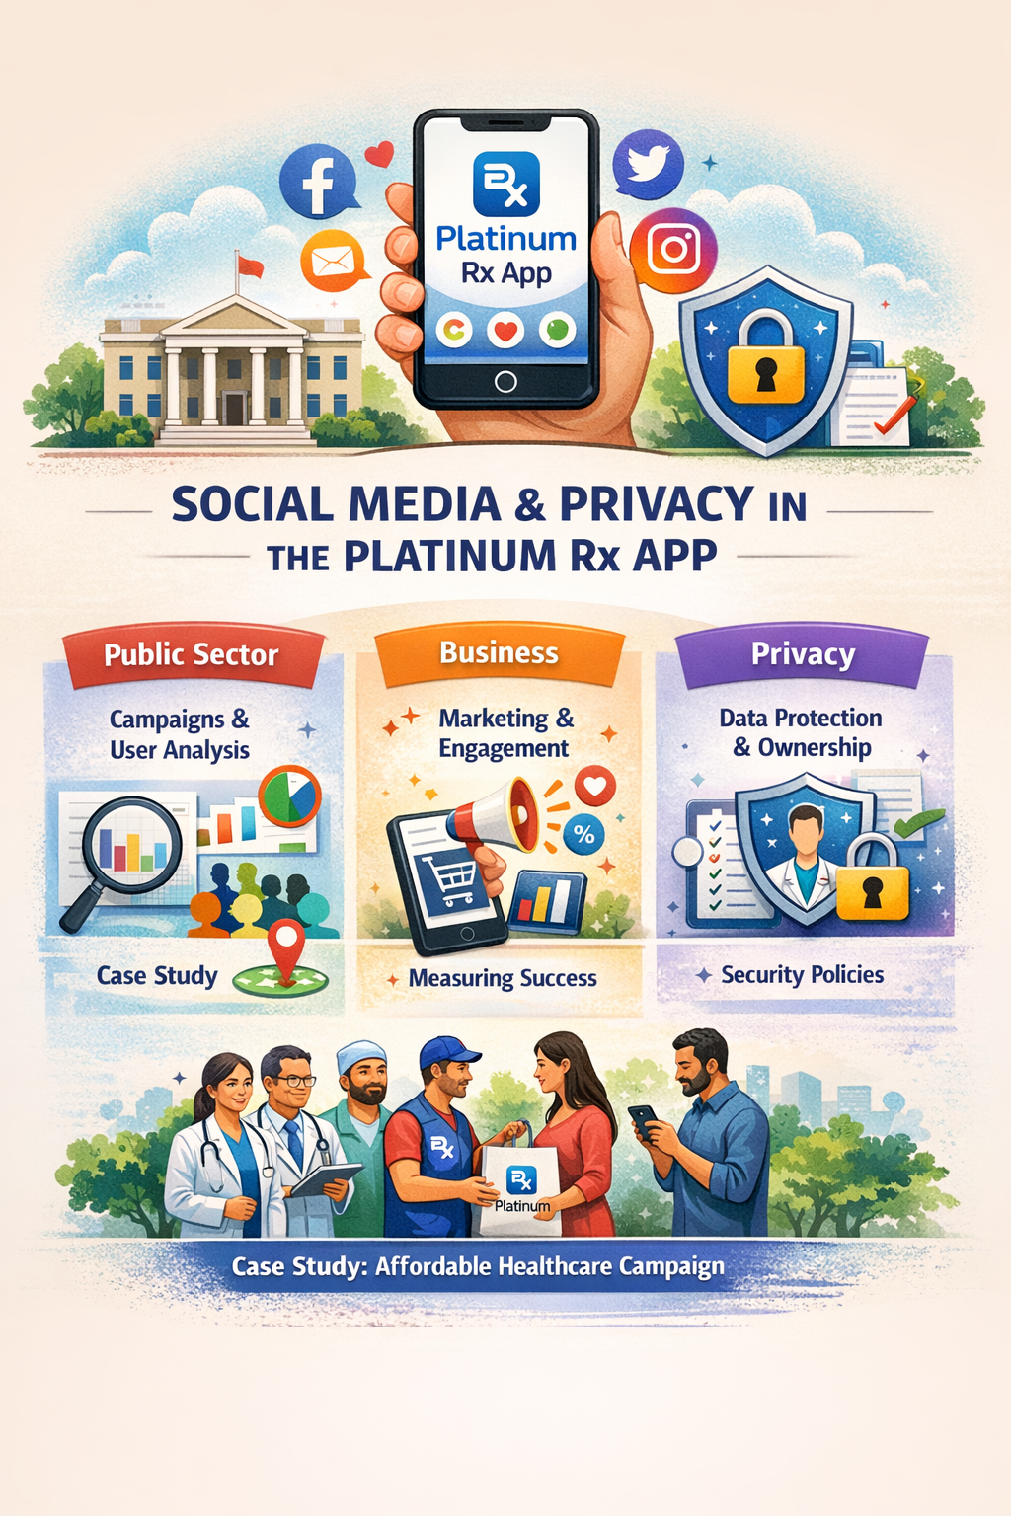

Slide 44
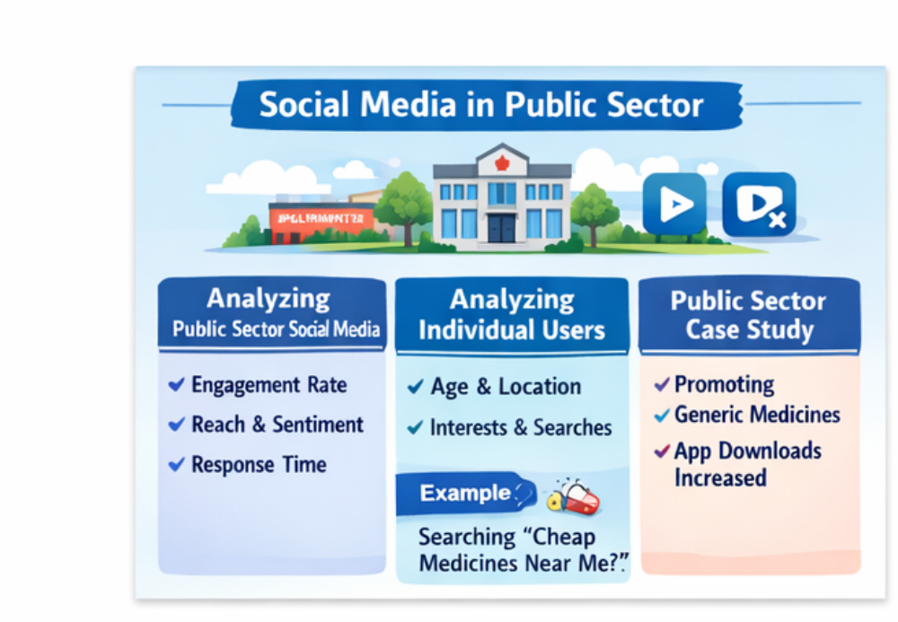

Slide 45
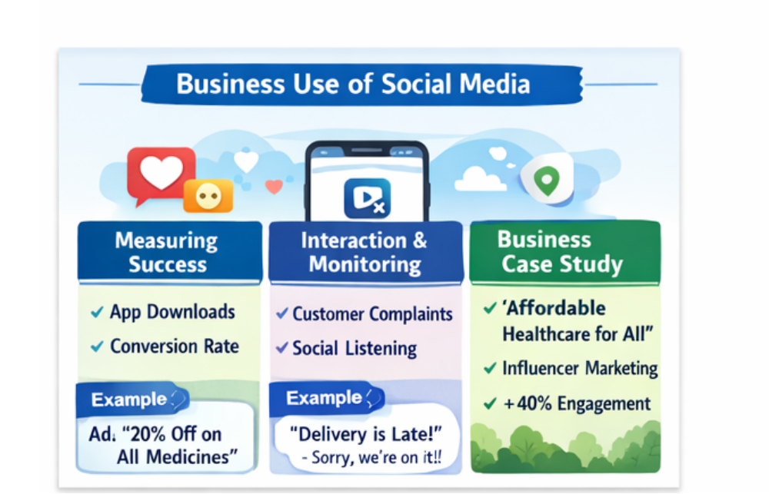

Slide 46
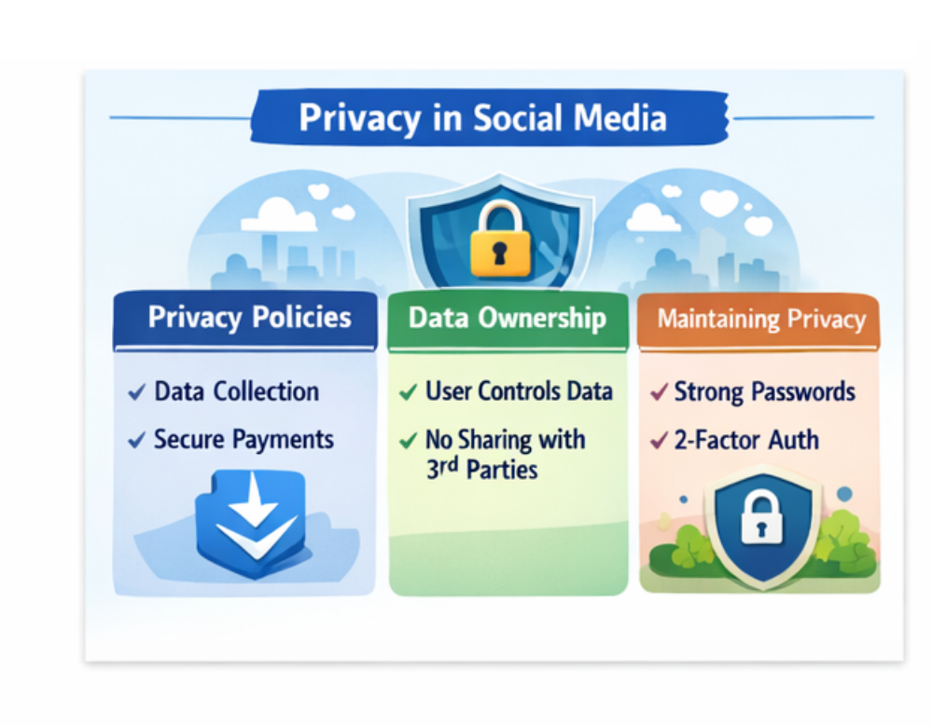

Slide 47
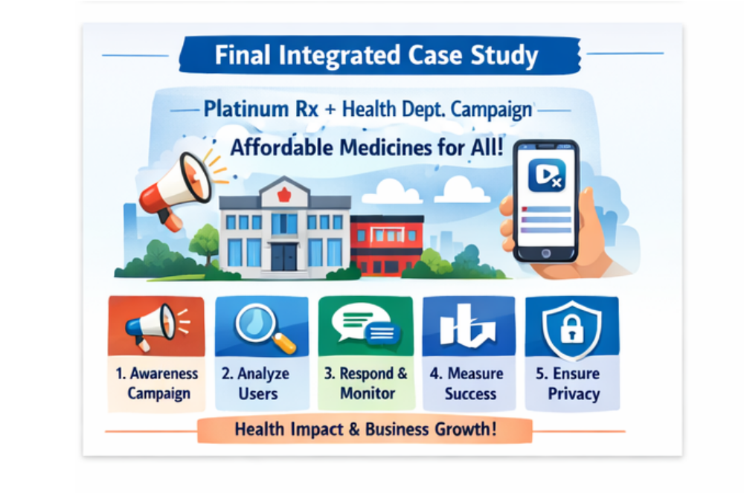

Slide 48
Share market apps
Feature | Zerodha Kite | Upstox
Brokerage | ₹0 delivery, ₹20 intraday | ₹20 per trade
Charting | Advanced (TradingView, 100+ indicators) | Good but slightly less polished
Speed | Very stable & reliable | Fast but improving
UI | Clean & simple | Modern but slightly cluttered
Learning | Strong (Varsity platform) | Limited learning tools
Beginner Friendly | Medium | High
Best For | Serious traders | Beginners & casual users

Slide 49
1. Two-Factor Authentication (2FA)
  Password + PIN/OTP
Protects account even if password is stolen

Slide 50
2. Encrypted Data Transmission
Ensures:
Login data
Transactions
are secure during transfer.

Slide 51
3. Regulatory Compliance
Follows rules of:
Securities and Exchange Board of India
Ensures secure and transparent operations

